Slide 1

Cuda raytracer
Jacobo Larsson linares

Slide 2
What is cuda?
Compute Unified Device Architecture
API for GPGPU programming
C++ syntax
Only available for Nvidia GPUs
Used in machine learning, physics engines, cryptographic hash functions…etc

Slide 3
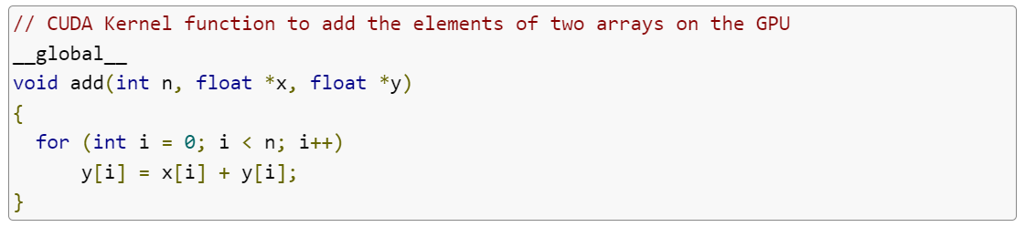
The cuda api
Code is divided into host (run on CPU) and device (run on GPU) code
Device functions are called kernels
Function identifiers:
__host__: runs on CPU, callable only from host code
__device__: runs on GPU, callable only from device code
__global__: runs on GPU, callable from both host and device code

Slide 4
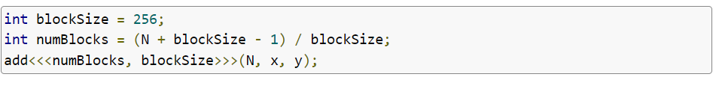
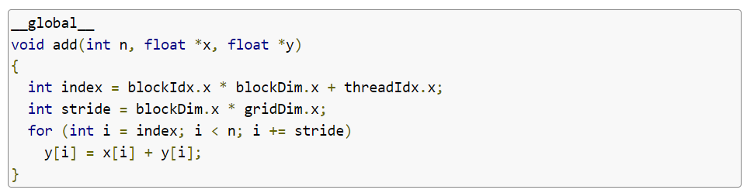
The cuda api
Thread count = 1
Thread count = blocksSize * numBlocks

Slide 5
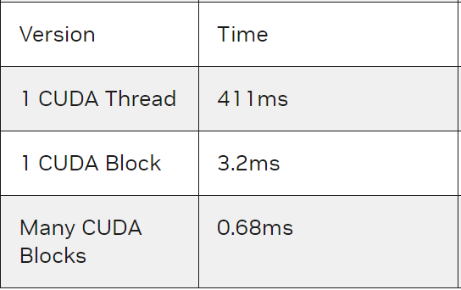
The cuda api
Statistics for calling add(n, x, y) with n = 1,000,000
GPU: GeForce GT 750M

Slide 6
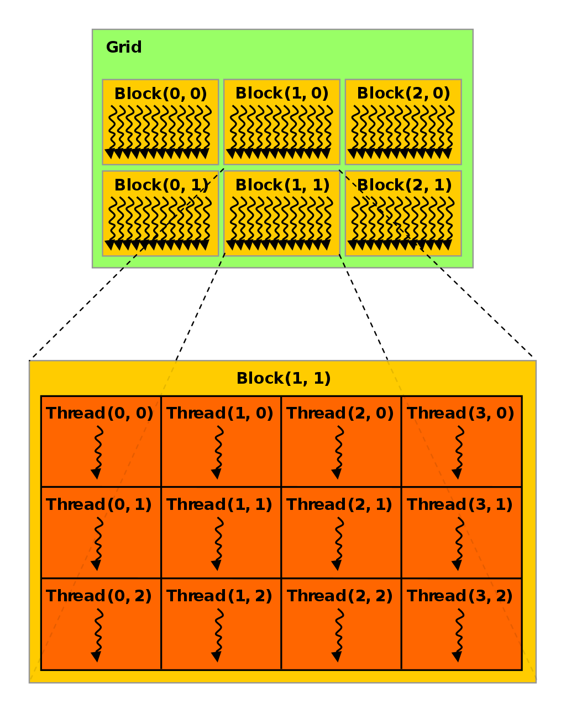
Thread hierarchy
Threads are grouped into thread blocks
A thread block may contain up to 1024 threads
Multiple blocks are combined to form a grid
Threads and blocks can have up to three dimensions for their indices

Slide 7
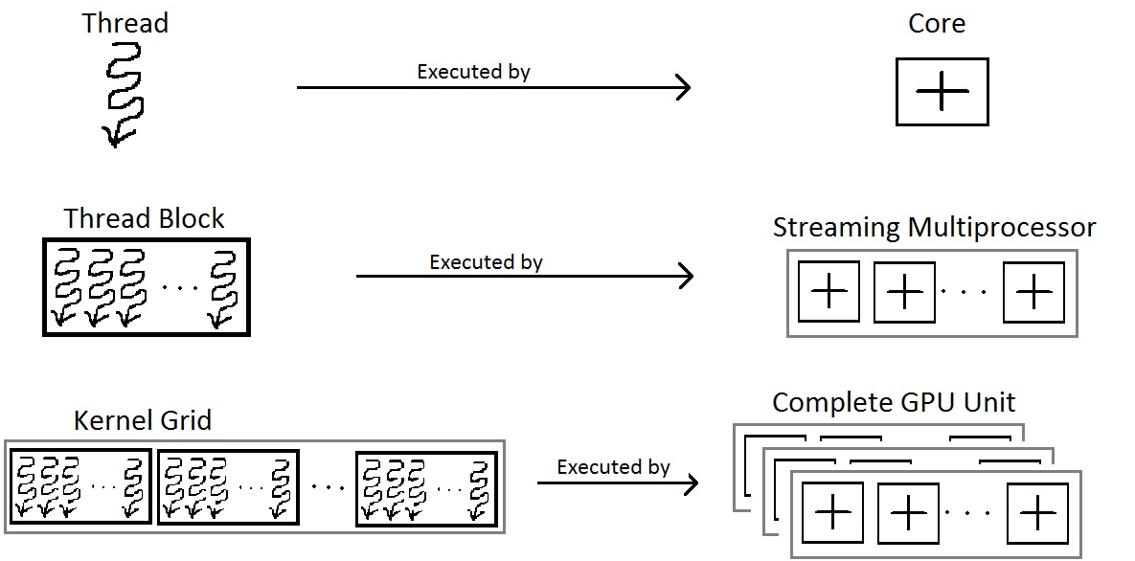
Threads from hardware perspective
Threads inside a thread block are divided into wraps, and all threads inside a warp execute the same instruction.
Several thread blocks are assigned to a Streaming Multiprocessor(SM). The block count per SM depends on the requested blocks and the number of SMs in a GPU

Slide 8
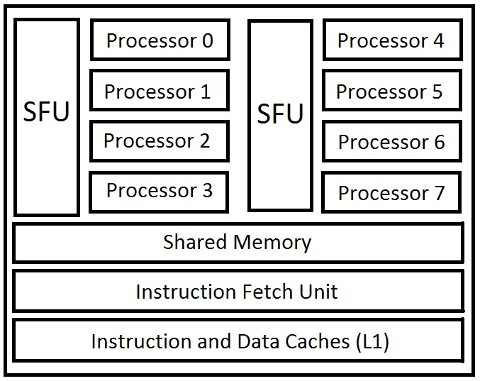
Streaming multiprocessors
General purpose processors with low clock rate and small cache. Supports instruction-level parallelism but not branch prediction. Composed of :
Execution cores
Single and double precision floating point units
Special Function Units (cos, sin, 1/sqrt, log2…etc)
Caches and shared memory
Thousands of registers
Schedulers for warps (in charge of issuing instructions to warps)

Slide 9
Streaming multiprocessors
May contain up to 8 thread blocks.
When the SM executes a thread block, all the threads inside the block are executed at the same time
To free the memory of a thread block, all the threads within it must have finished execution, so threads within a block should take about the same time to finish, to avoid inactivity
Only threads in the same block have access to shared memory

Slide 10
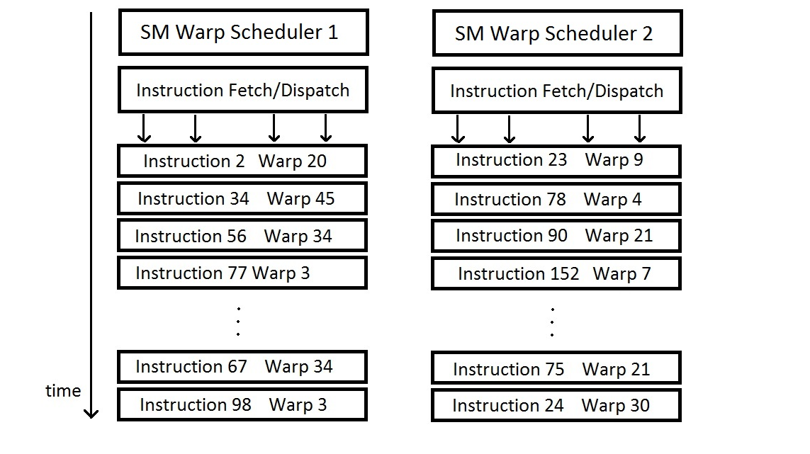
warps
SIMT (Single Instruction Multiple Thread) execution model
Set of 32 threads within a thread block, so thread count per block should be multiple of 32
All the threads in a wrap execute the same instruction
A warp is done with execution only when all the threads inside it are done

Slide 11
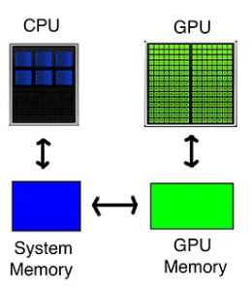
Memory hierarchy
In order to access memory in kernel functions, we must allocate it in the GPU RAM, but memory allocated in the GPU RAM must be copied onto RAM for the host to be able to access it
There are four five of memory allocation with CUDA:
Pageable memory
Pinned memory
Mapped memory
Unified memory
GPU memory

Slide 12
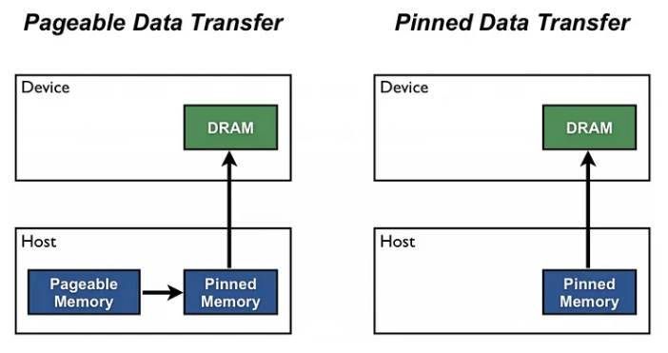
Memory hierarchy: pageable and pinned memory
The memory allocated by the host is by default pageable. To use this data in the GPU we must make a transfer, but CUDA implicitly copies this memory into a temporary pinned memory buffer, and then transfers it to the device
We can avoid this by directly allocating pinned memory.

Slide 13
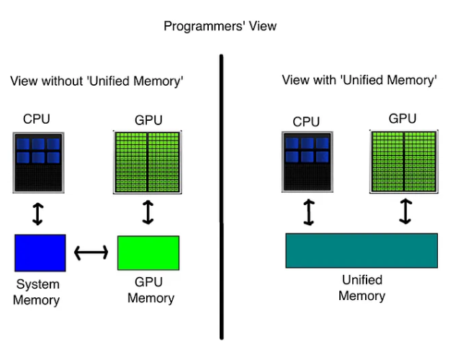
Memory hierarchy: mapped and unified memory
Mapped memory is pinned memory that can be mapped into a device address. Data will not be copied into device memory, but transfers will happen during execution
Unified memory is a pool of memory which is accessible by both device and host, but data migration still happens under the hood

Slide 14
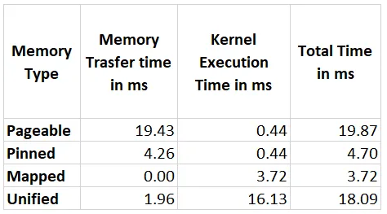
Memory hierarchy: comparisons
These are some statistics of the use of the different types of memory allocation for a function that takes two arrays of 1,000,000 elements and sums them.

Slide 15

Cuda Raytracer implementation: milestone 1
Render function runs in GPU
One thread per pixel
Thread blocks of 8x8 in size
Unified memory for the frame buffer
Scene objects allocated in the GPU RAM

Slide 16
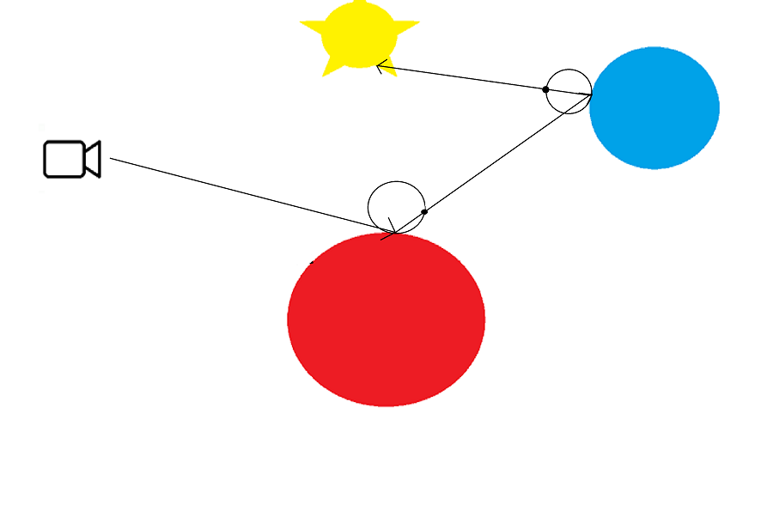
Cuda Raytracer implementation: milestone 2
Rays now bounce off objects when they collide with them, but the new ray needs randomness to be created.
We need the same number of random generators as current threads running.

Slide 17
Cuda Raytracer implementation: milestone 2
A random number generator is created for each thread using cuRAND, with the thread index being the seed
Pixel samples are taken from casting rays multiple times per thread
Mapped memory for the frame buffer

Slide 18
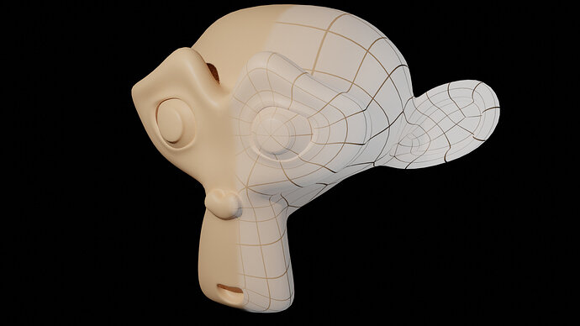
Cuda Raytracer implementation: milestone 3
Now there are complex meshes in the scene
High amounts of polygon intersection tests per thread would cause timeouts, and the program would crash

Slide 19
Cuda Raytracer implementation: milestone 3
New approach:
Call the render function multiple times with smaller sample number
Accumulate the results of the render function
Problem:
We must wait until all the pixels in the screen are done rendering to execute the next kernel call

Slide 20
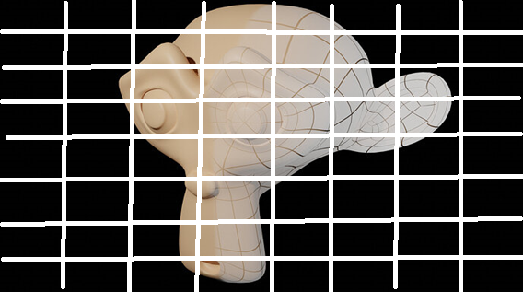
Cuda Raytracer implementation: milestone 3
Final approach:
Divide the image into uniform squares
Run the kernel function for each of these squares
Assign to every pixel a thread block, where the thread count is the desired amount of samples
Number of samples per pixel should be multiple of 32
Store the accumulated color value in shared memory

Slide 21
Cuda Raytracer implementation: Results
Run with a Geforce GTX 980
Parameters for both executions:
128 samples per pixel
10 bounces per ray
1024x1024 resolution
X93 speedup
Single threaded: 3 minutes and 7 seconds
CUDA: 1.992 seconds

Slide 22
Cuda Raytracer implementation: Results
Run with a Geforce GTX 980
Parameters for both executions:
128 samples per pixel
10 bounces per ray
1024x1024 resolution
X109 speedup
Single threaded: 9 minutes 35 seconds
CUDA: 5.259 seconds

Slide 23
Cuda Raytracer implementation: Results
Run with a Geforce GTX 980
Parameters for both executions:
128 samples per pixel
10 bounces per ray
1024x1024 resolution
X3 speedup
Single threaded (with kd-tree accelerator): 4 minutes and 57 seconds
CUDA (without kd-tree accelerator: 1 minute 42 seconds

Slide 24
Plans for future
Improve bandwidth usage by preforming parallel memory transfers
Test different types of memory allocation
Make the render kernels run in parallel
Use shared memory to avoid cache misses
Implement other raytracing techniques

Slide 25

end

